Slide 1

Connected Samurais Behavior Driven Development (BDD) with Page Object Model Pattern (POM) using Java Selenium Cucumber

Slide 2
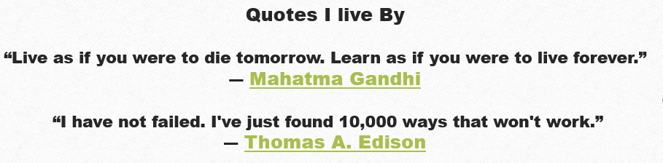
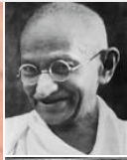
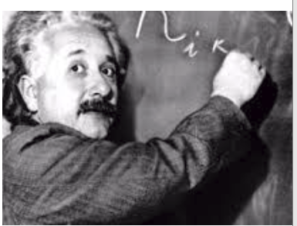
About Ulfat Ashraf
Software Developer Engineer in Test
Good Exposure in Finance and Automotive Domain
Noteworthy Work Experience: Fannie Mae, Freddie Mac, Bank of America, E*TRADE Financial, General Motors Financial, Department of Defense
Education MS in Information Technology, Univ of Maryland, College Park, MD
Certificates in Finance, Accounting & Marketing, Bentley University, Waltham, MA
CompTIA Security + Certified

Slide 3
AGENDA
Step Definition
CICD - Jenkins
BDD Overview
Test Execution
Feature File
Page Object Model pattern

Slide 4

BDD Overview
Notes:
What Is DevOps?
https://theagileadmin.com/what-is-devops/
lynda.com/LinkedIn Learning (Free for Plano Library Card Holders)
DevOps Foundations (James, Ernest) – a three hour set of videos designed to orient beginners into the whole scope of DevOps.
https://www.lynda.com/Operating-Systems-tutorials/DevOps-Fundamentals/508618-2.html
DevOps Foundations: Infrastructure Automation (James, Ernest) – two hours of infrastructure automation concepts, with demos illustrating them in everything from Cloudformation to chef.
https://www.lynda.com/IT-Infrastructure-tutorials/DevOps-Foundations-Infrastructure-Automation/574705-2.html
DevOps Foundations: Continuous Delivery (James, Ernest) – what you need to know about continuous integration and delivery, with demos in jenkins, nexus, and more.
https://www.lynda.com/IT-Infrastructure-tutorials/DevOps-Foundations-Continuous-DeliveryContinuous-Integration/606079-2.html

Slide 5
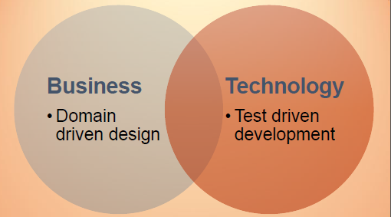
BDD

Slide 6
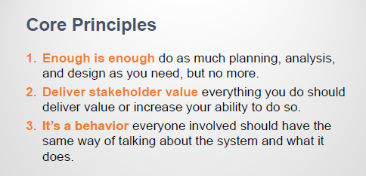
BDD

Slide 7
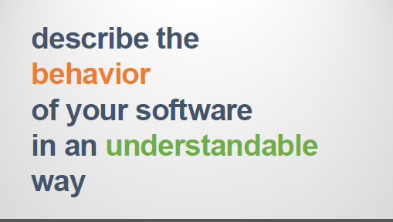
BDD

Slide 8
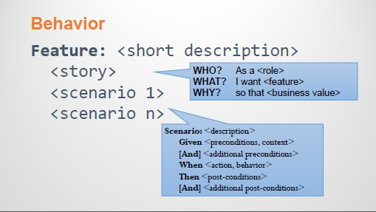

Slide 9
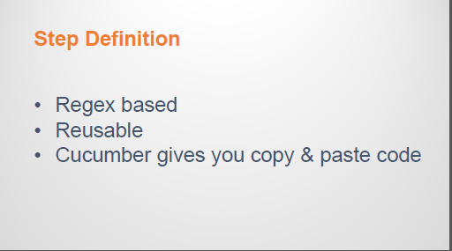
What is Step Definition?

Slide 10
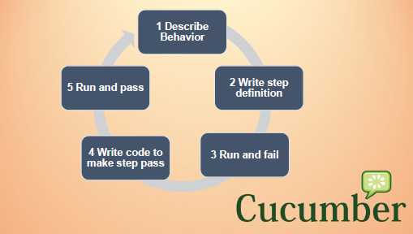

Slide 11
Why Should We Adopt BDD? https://confluence.sdlc.toyota.com/display/CTP/Page+Object+Model+pattern+with+BDD+using+the+Java+Spring+Framework+Automation
Notes:
What DevOps Means To Me
John Willis
https://www.chef.io/blog/2010/07/16/what-devops-means-to-me/
DevOps Culture
John Willis
http://itrevolution.com/devops-culture-part-1/
People over Process over Tools
Damon Edwards
http://dev2ops.org/2010/02/people-over-process-over-tools/

Slide 12
Page Object Model Pattern (POM)

Slide 13
Page Object Model Pattern – What and Why adopt POM?
https://confluence.sdlc.toyota.com/display/CTP/Page+Object+Model+pattern+with+BDD+using+the+Java+Spring+Framework+Automation
https://www.seleniumhq.org/
https://www.seleniumhq.org/docs/06_test_design_considerations.jsp#page-object-design-pattern

Slide 14
Application Under Test (AUT) in Diff Environments
https://harness.dev.telematicsct.com/
https://harness.qa.telematicsct.com/
https://harness.stg.telematicsct.com/

Slide 15
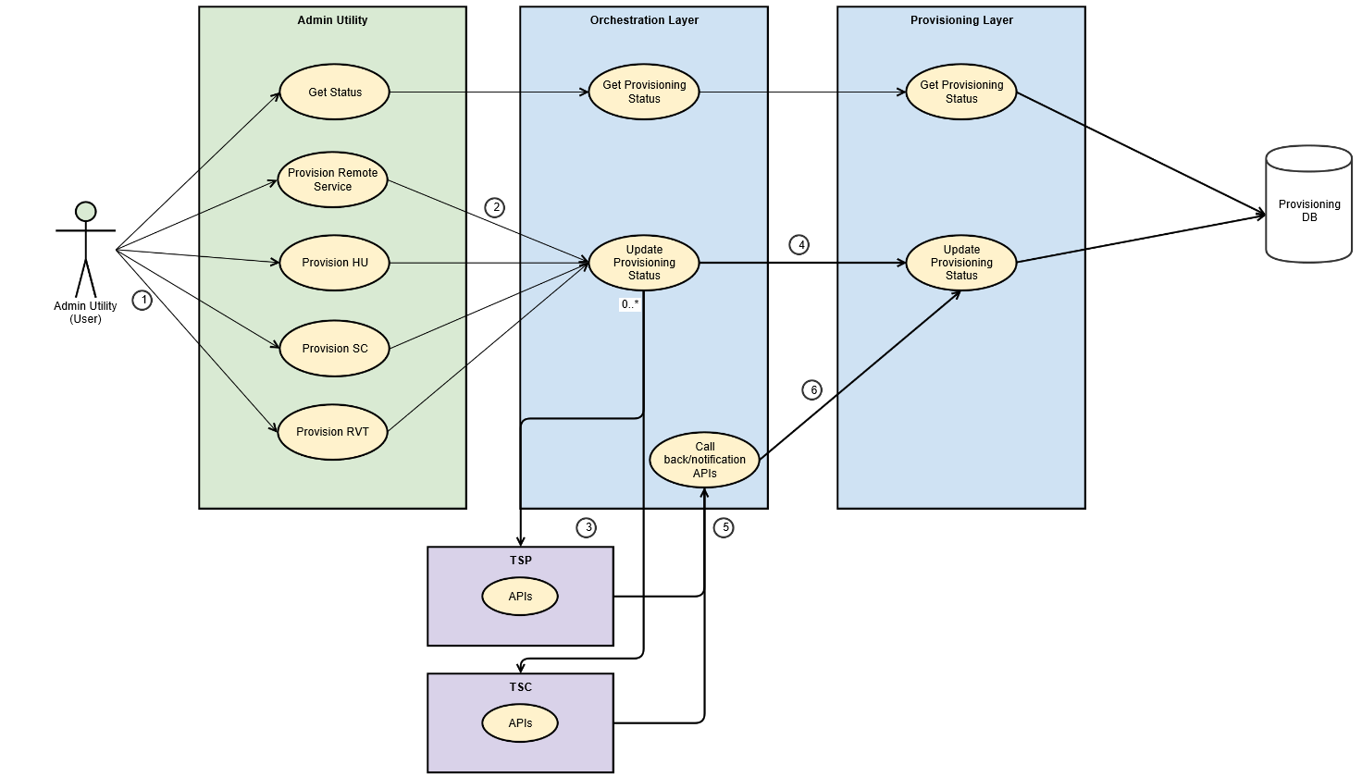
Flow of Test Harness Application

Slide 16
Our Framework using BDD and POM
Let’s watch a life Demo of UI

Slide 17
Our Framework using BDD and POM
Our Framework using BDD and POM
Let’s watch a life Demo of API Testing

Slide 18
Continuous Delivery

Slide 19
Fast, Constant Feedback
Source: Jez Humble https://continuousdelivery.com/images/pipeline-sequence.png

Slide 20
From local Machine to a CICD Tool - Jenkins
Life Demo to a Jenkins job Run with a Report

Slide 21
Next Steps

Slide 22
Next Steps for Automation Framework
Work begins at the team level to implement BDD & POM & Java Spring boot Framework best practices for Automation
Training and mentoring for teams
Scoring and ranking of teams based on maturity levels for Automation testing

Slide 23
Questions?

